Slide 1




A Dorset Perspective On Climate Change Mitigation
Corfe Parish Council
Derek Moss

Slide 2

Contents
Introduction
Motivations
Global and National Progress
Dorset
Things Businesses Can Do
Things Households Can Do
Things People Can Do

Slide 3
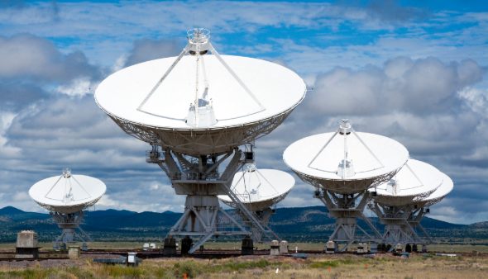
Introduction
Derek Moss
  Low Carbon Dorset Technical Officer
  Assess buildings for weaknesses and suggest improvements
  Nosey and Bossy
  Previously: Corfe Castle First
  School
  Now do this

Slide 4
Low Carbon Dorset
Free Technical support
  Identify options
  Hand hold through development
  & implementation
  Support funding application
Grant Funding 40%
Free Low Carbon Workshops
Free Networking Events
Case Studies &
Demonstration Projects
Notes:
Available to –
Legally constituted voluntary or community organisations
Registered charities
Workshops – low carbon opportunities,
Networking Events – Share ideas, good practice etc..
Grant –
Match needed typically 60%
Specific eligibility criteria each priority – Innovation, not standard measures
Capital & revenue costs
All stages development & implementation
FREE support
Technical advice on project ideas
Support developing grants applications, other funding opportunities
Hand holding

Slide 5
Motivations
Motivations
  Climate Change (EMERGENCY!!!)
  Peak Oil
  Energy Security
  Running costs (increasing!)

Slide 6


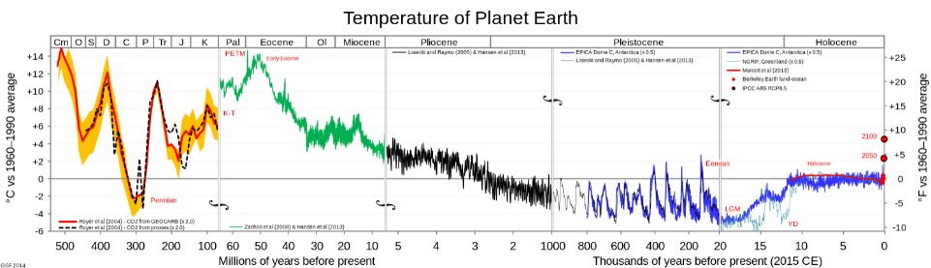
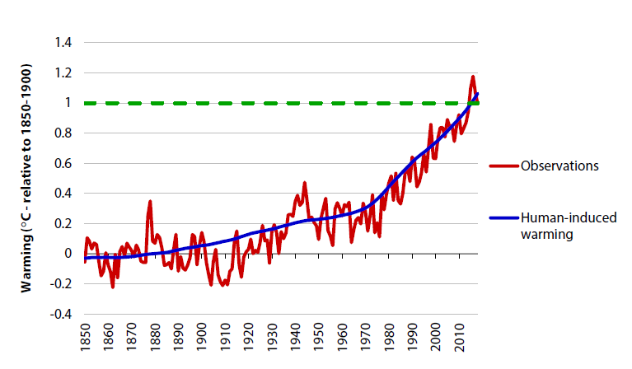
Motivations

Slide 7
Global and Nation Progress
Climate Change Policy:
Global:
Paris Climate Accord
Humankind committed to keeping warming down to below 2ºC, and hoped to keep it below 1.5ºC
1.5ºC involves only 1.5 billion people being exposed to multiple severe climate risks
It has since presented a set of targets, which give a 3ºC warming, and a plan to achieve those targets, which gives a 4ºC warming
IPCC 1.5 degrees report

Slide 8
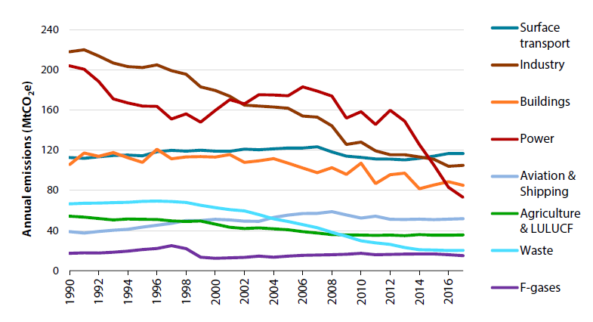
Global and Nation Progress
Climate Change Policy:
  UK:
    1% of the world population
    1% of world emissions
    But we started the industrial revolution
    2008 Climate Change Act
      Target of 80% reduction of GHG emissions by 2050
      World-leading amazingness!!
      Initially made good progress
      July 2019: Updated it to say 100% reduction

Slide 9
Global and Nation Progress
Climate Change Policy:
  EMERGENCY!!!!!!!!!!!!!!!
    1.5ºC target
    Physics models
    Total emission budget
    500 billion tonnes of CO_{2e} to have a 50% chance of staying below 1.5ºC
    Current emissions:
      55 billion tonnes per year
      500 / 55 = EMERGENCY!
      <10 years at the current rate

Slide 10
Global and Nation Progress
UK’s Plan (official [ish]):
  ……………
  …………….
  …………….
  …………….
  …………….
  Worry about it later?

Slide 11
Global and Nation Progress
UK’s Plan (according to CCC):
  By 2050:
  Ban all combustion of gas and oil
  Ban all combustion of petrol and diesel
  All heating off the gas grid will be biomass or electric
  All heating on the gas grid will be hybrid ASHP and hydrogen
  All ground transport will be electric or hydrogen
  All hydrogen will be zero carbon
  All electric will be zero carbon
  Some direct carbon capture needed too

Slide 12
Dorset
Dorset
  At Dorset Council’s first meeting, it declared a climate emergency (applause please)
  We have not just set a target with no plan
  Now trying to decide on:
    The scope of the response (own operations or whole area)
    What can realistically be done
    When it can be done by
  Set up an official Climate Emergency Advisory Panel (Council Members) and a Technical Officers group.
  A plan is being developed

Slide 13
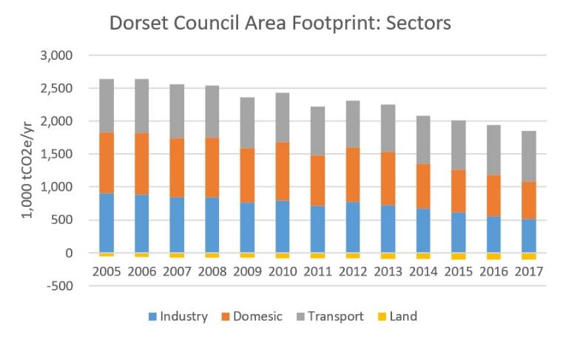
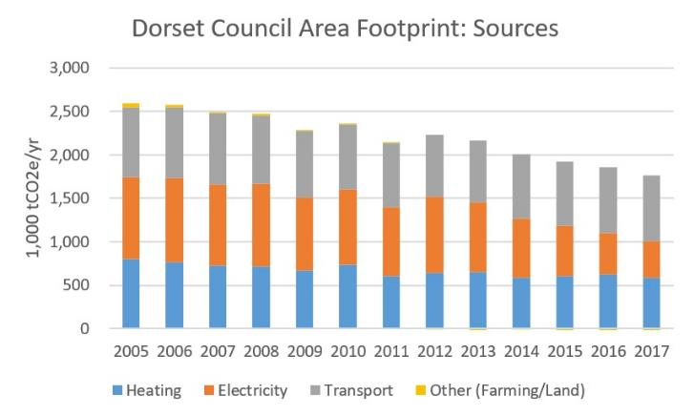
Dorset
Dorset Area (not BCP)

Slide 14
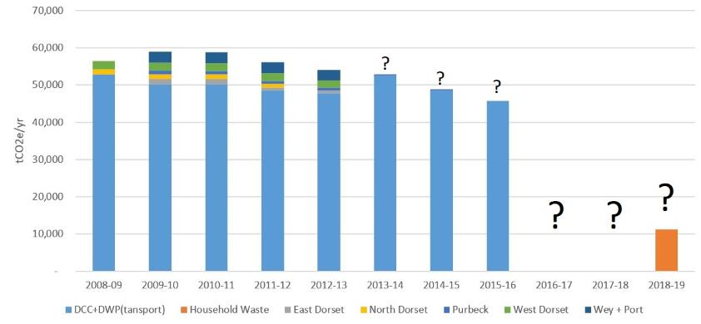
Dorset
Dorset Council itself
Most efficient schools in the country
Early adopters of low-energy street lighting
Regularly top county in the recycling leagues

Slide 15
Dorset
Dorset’s Requirements
  In 2013, the Bournemouth, Dorset, and Poole Renewable Energy Strategy determined that, by 2020, Dorset will be using around 16 billion kWh/yr
  This means (very roughly) 5 to 9GW of renewable electricity and hydrogen generation (5,000 to 9,000 MW) will be needed by 2050.
  Anyone know what we’ve got?
  480-odd MW of electricity, no hydrogen
  Roughly a 1000-fold increase is needed
  At least a 25-fold increase is needed
  The 1000-fold requirement is the increase in spending

Slide 16
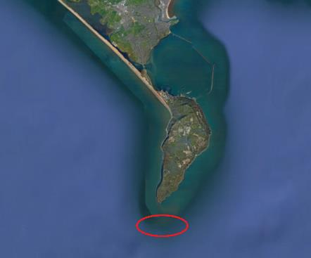
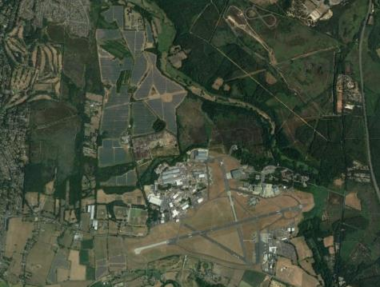
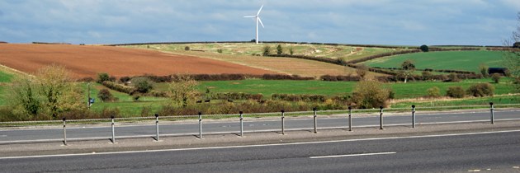
Dorset
Dorset’s Opportunities
  Many many small scale (see later)
  Large Scale is what is needed
  Portland tidal stream farm
  Best county in the country for solar PV
  A vast unused onshore wind resource
  A vast unused offshore wind resource
  Not as much wave or tidal energy as one might think

Slide 17
Dorset
Dorset’s Opportunities
  Small scale:
  We are the only place in the country where there are subsidies for renewable electricity generation
  Low Carbon Dorset
  Focussed on businesses
  Some grant money for Community Groups and Public Sector
  Can’t help individuals
  Running for 1 more year

Slide 18
Businesses

Slide 19
Business Impacts
Dorset’s Business
    Industry accounts for around 30% of Dorset’s carbon footprint

Slide 20
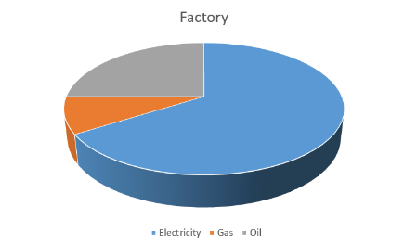
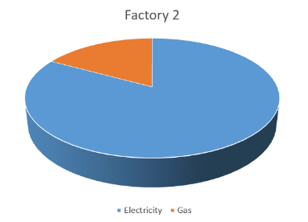
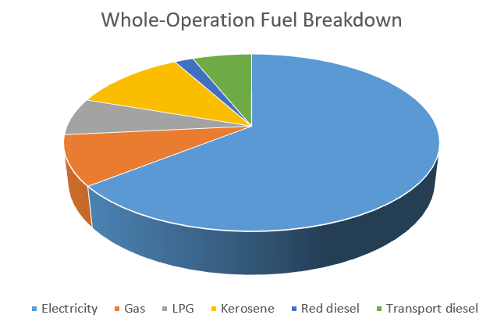
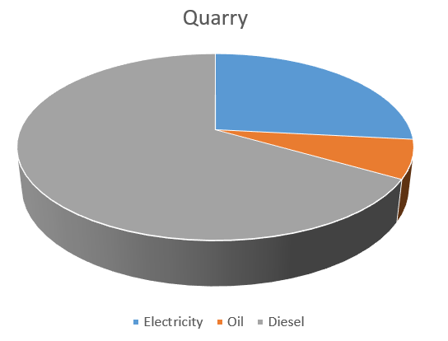
Business Impacts

Slide 21
Actions (All)
Measure Your Impact
  It’s simple to record your electricity, gas and oil/petrol/diesel use
  See if it changes year by year
  There are simple conversion factors:
    Electricity: 0.517 kgCO_{e}2 per kWh (and falling)
    Gas: 0.211 kgCO_{e}2 per kWh
    Oil: 3.52 kgCO_{e}2 per litre
    LPG: 0.259 kgCO_{e}2 per kWh
    Diesel: 3.17 kgCO_{e}2 per litre
    Petrol: 2.65 kgCO_{e}2 per litre

Slide 22
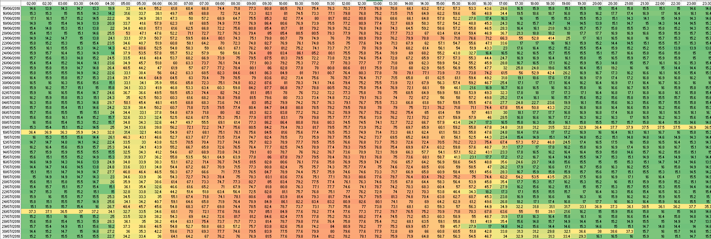
Actions (Business)
Measure Your Impact
  Do you have a Smart or Half Hourly electricity meter?

Slide 23
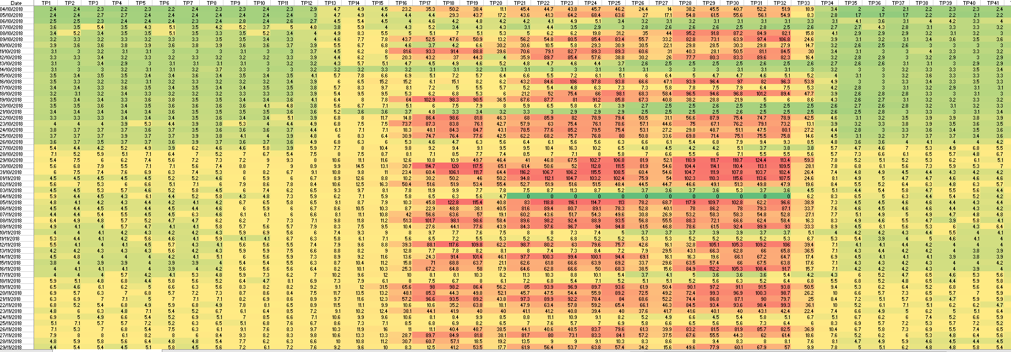
Actions (Business)
Waste
  Do you/your staff:
  Leave the lights on?
  Leave heating on?
  Leave drinks machines on?
  Have heating and cooling running in the same space?
  Cool an area which is heated by the sun, when you could just close blinds?
  Have a open-front fridge in a small room?
  Not regularly check a compressed air system for leaks?
  These could be costing £100’s to £1,000’s per year

Slide 24
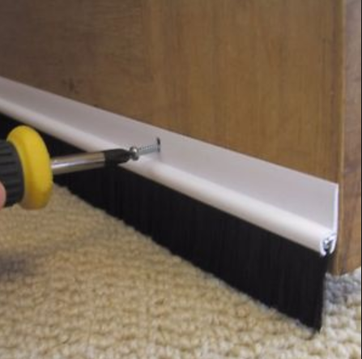
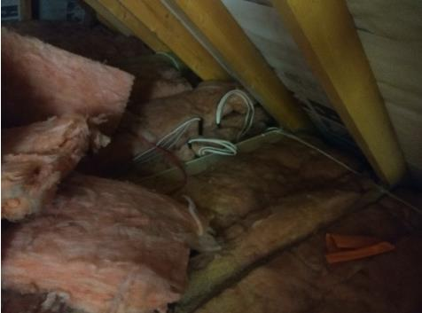
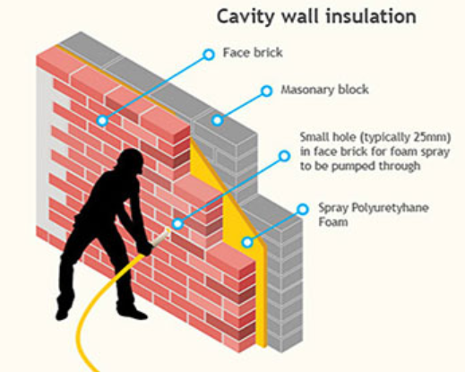
Actions (All)
Efficiency
  Thermal
  Cost: £10’s to £1,000’s
  Paybacks of 2 to 4 years

Slide 25
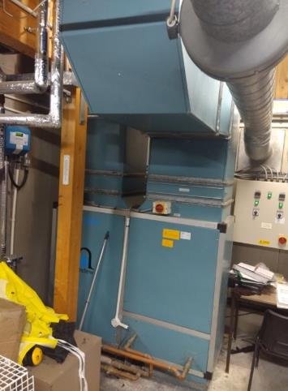
Actions (Business)
Efficiency
  Thermal
  Cost: £1,000’s to £10,000’s
  Paybacks of 5 to 8 years

Slide 26
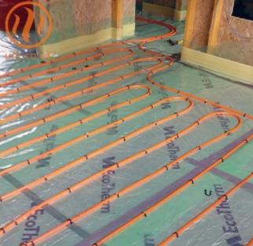
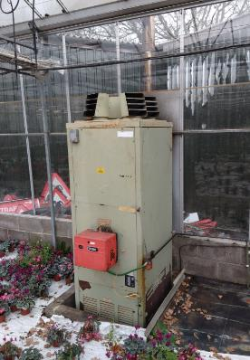
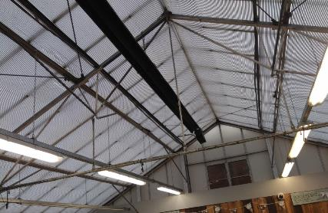
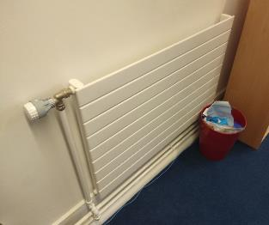
Actions (Business)
Efficiency
  Heating System
    Heat distribution
  Wastes: £100’s to £1,000’s per year
  Costs to change: £1,000’s to £10,000’s
  Paybacks depend on heat source

Slide 27
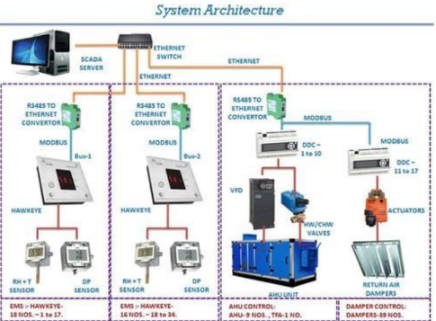
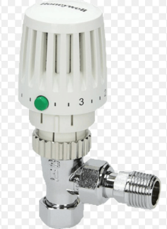
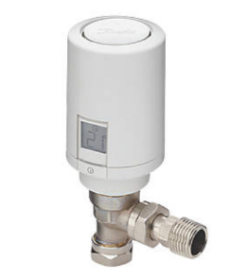
Actions (All)
Efficiency
  Heating System
    Controls
  Costs: £100’s to £1,000’s
  Paybacks of 2 to 10 years

Slide 28
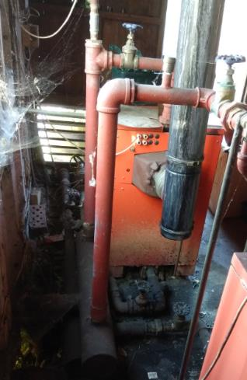
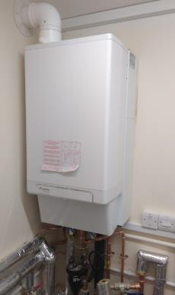
Actions (All)
Efficiency
  Heating System
    Heat Source
    26% saving?
    £3k-£4.5k/yr
  Costs: £1,000’s to £10,000’s
  Paybacks of 3 to 8 years

Slide 29

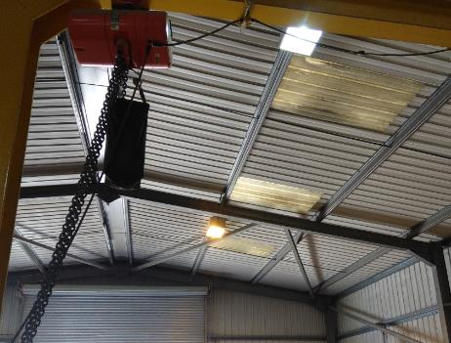

Actions (All)
Efficiency
  Electrical
    Lighting
  Cost: £10’s to £10,000’s
  Paybacks of 2 to 4 years

Slide 30
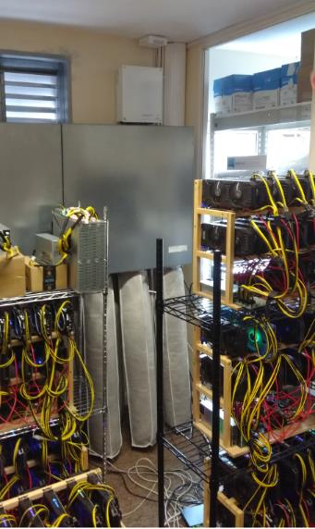
Actions (Business)
Efficiency
  Electrical
    Free Air Cooling
    Cellars and server rooms
    Generally acceptable T is > outdoor T
  Cost: £1,000’s to £10,000’s
  Paybacks of 2 to 5 years

Slide 31
Actions (Business)
Efficiency
  Electrical
    Others
      Endocubes in fridges
      Induction hobs rather than gas hobs
      Modern equipment vs. old
      Sector-specific
      Often nothing that can be done

Slide 32
Actions (All)
Renewable Energy
  Electrical
    Solar PV
    Wind
    CHP
  Heat
    Solar thermal
    Heat Pumps
    Biomass
    CHP

Slide 33
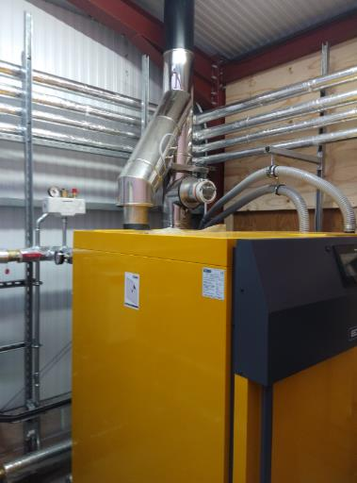
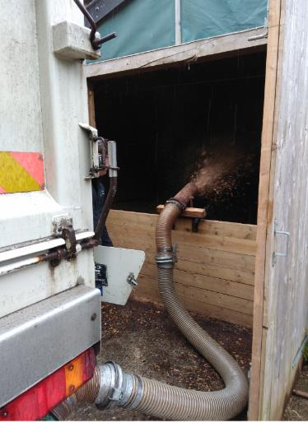
Actions
Biomass Heating
  Burning wood instead of fossil fuels
  Normally the largest carbon saving giving by any single measure
  Grant and RHI subsidy
  Especially good financially if off gas grid
  Cost: £10,000’s to £100,000’s
  Paybacks of 5 to 12 years

Slide 34
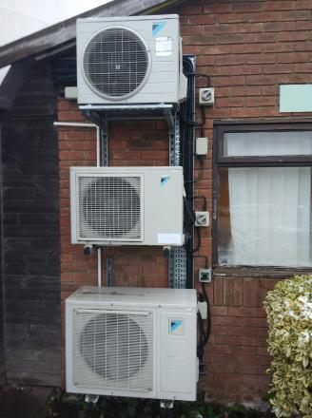
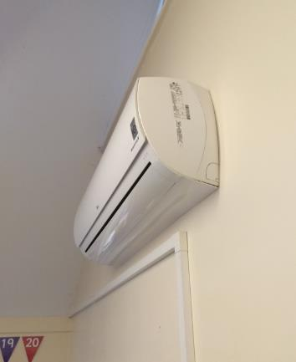
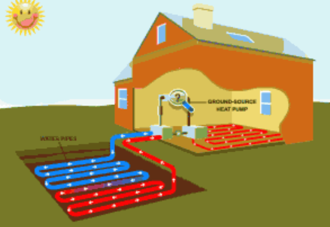
Actions
Heat Pumps
  The future of heating?
  Already widespread
  Work like a fridge
  Up to 500% efficiency
  Air-source or ground-source
  Grant and RHI subsidy
  Works best with underfloor heating
  Likely to be needed even on the gas grid
  Cost: £1,000’s to £10,000’s
  Paybacks of 5 to 10 years

Slide 35
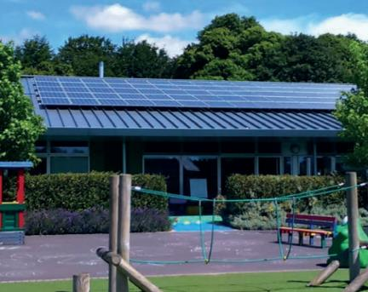
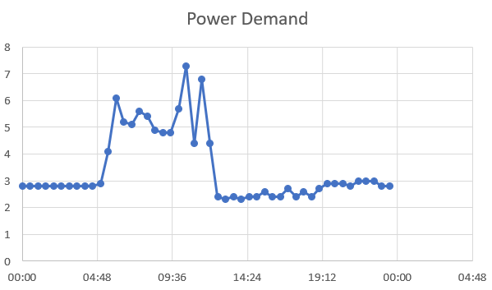
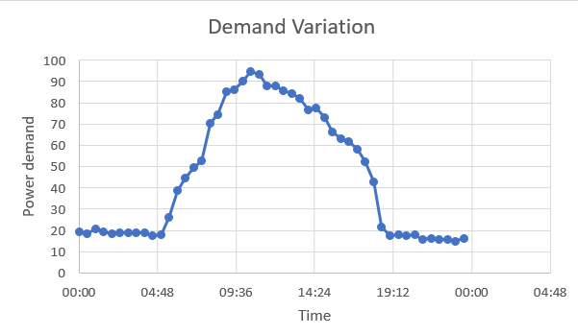
Actions
Solar PV
  The simplest system
  Will need to be everywhere
  Economics complex:
    No subsidy (or export for small arrays)
    Demand size
    Demand timing
  Cost: £1,000’s to £10,000’s
  Paybacks of 3 to 6 years (good site)
  or 10 to 60 years (bad site)

Slide 36
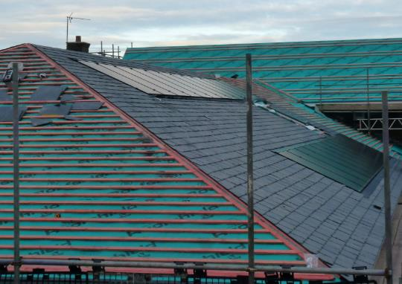

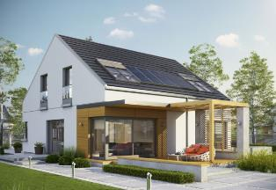
Actions
New Build?
  Are you planning a new building?
  The legal requirements for energy efficiency are still lax
  You can do much better
  No heating required?
  Integrate solar PV?
  Heat pumps (hybrid?)
  Cost: £1,000’s to £100,000’s
  Paybacks of 4 to 20 years

Slide 37
Actions (All)
Green Tariffs
  Please sign up to them
  Please do not necessarily believe the claims
  Please do not think that they reduce your carbon footprint
  They are not linked with any increase in renewable energy generation

Slide 38
Actions (Business)
Transport
  Not our speciality
  Encourage staff to walk, cycle and lift share
  Work on train?

Slide 39
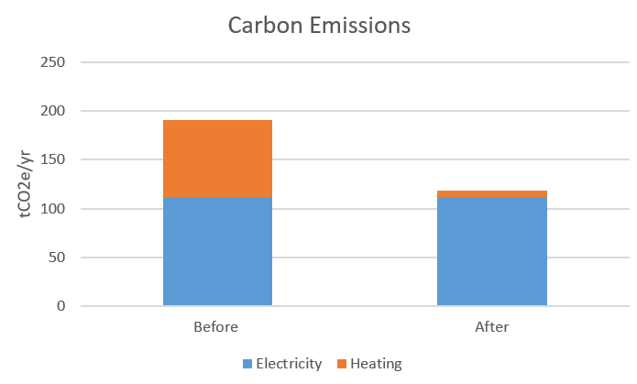
Business Examples
Factory Biomass
  90kW wood pellet boiler
  £63k before grant, £37k after
  £4.4k savings per year
  8 yr payback (20 yr lifetime)

Slide 40
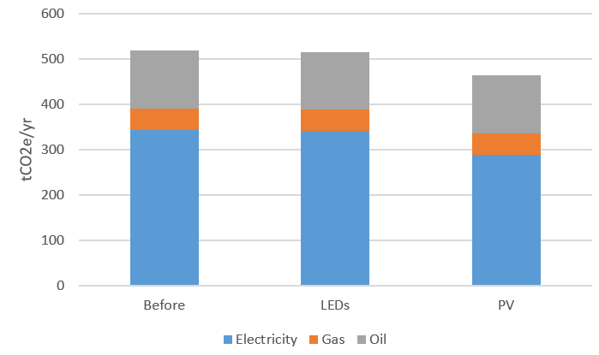
Business Examples
Old Factory PV and LEDs
  Factory with lots of CNC machines
  LEDs (£3k, 4 yr payback)
  110 kW solar PV (£60k, 5 yr payback)
  Repeatable across Dorset

Slide 41
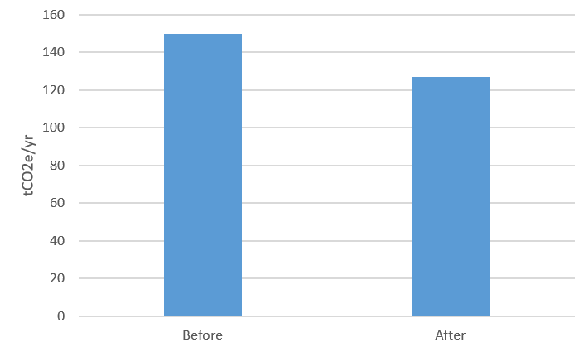
Business Examples
New Factory PV
  New Factory (again with lots of CNC machines)
  A-rated EPC (excellent insulation, LEDs throughout, excellent controls, air-source heat pumps)
  50 kW_{p} of solar PV
  £24k install, 3.6 yrs payback

Slide 42
Business Examples
Leisure Centre
  Large heat load
  Large ventilation load
  Switched to LEDs throughout
  Switched to Aerated showers throughout
  New ventilation ducting
  New pool-specific control system taking advantage of thermal inertia
  New air-source heat pumps
  £195k, 5 year payback
  195 tCO₂e/yr saving

Slide 43
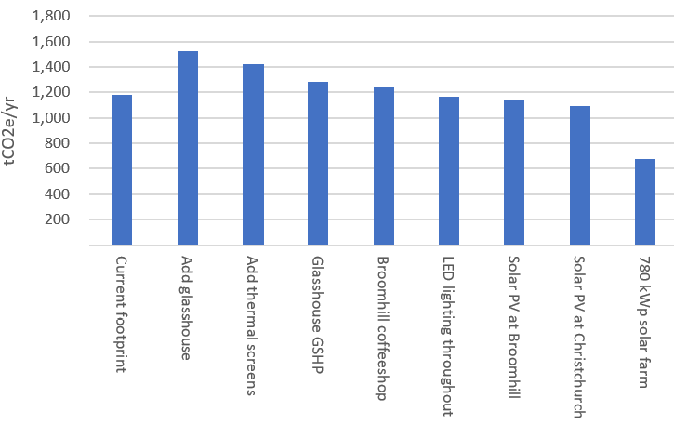
Business Examples
Garden Centre
  LEDs throughout (£65k, 4 yr payback)
  159 kW_{p} of solar PV (£69k, 5 yr payback)
  Fast-action automated roller delivery door (£8k)
  Thermal screens in a glasshouse (£55k, 8yr payback)
  Ground-source heat pump in a glasshouse (£180k, 4 yr payback)

Slide 44
Town/Parish Councils

Slide 45

Town/Parish Councils
Dorset’s Councils
    There are many Town and Parish Councils in Dorset
    Many have declared Climate Emergencies
    Many have asked us to help them write a plan
    We can’t
    But we will be running a workshop on:
    Tuesday 19th November
    Dorchester
    Please sign up

Slide 46
Homes

Slide 47
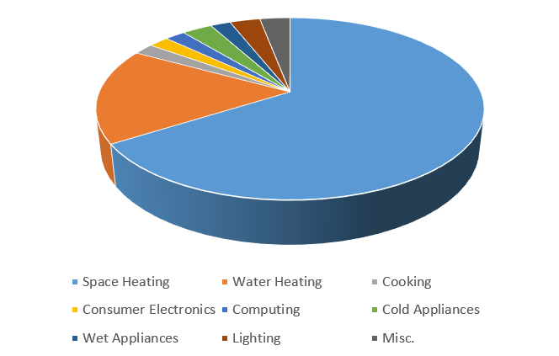
Home Impacts
Dorset’s Homes
    Industry accounts for around 33% of Dorset’s carbon footprint

Slide 48
Home Measures
Number 1 Action:
  INSULATE
  Healthy Homes Dorset can give grants
  https://www.healthyhomesdorset.org.uk/
  Don’t forget any hot water cylinder!

Slide 49
Home Measures
Other Actions:
  Turn down the thermostat and wear more clothes
  Radiator reflectors
  Control your heating in detail
  Close the curtains when the heating is on
  Switch to LED lights
  Use cold water rather than hot (washing machine)
  Install aerated shower and taps
  Dry your clothes outside, not in a tumble dryer, whenever possible
  Consider renewable energy

Slide 50
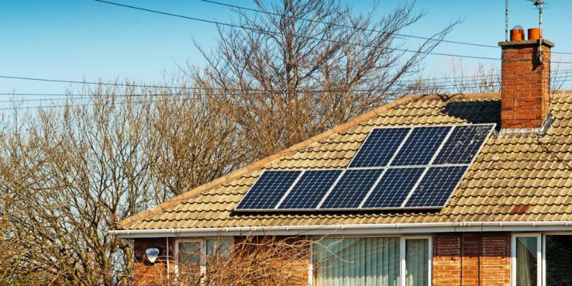
Home Measures
Renewable Energy: Wide-View Usefulness
  Every house should have PV
  Off the gas grid:
    switch to an ASHP or biomass
  On the gas grid:
    Either switch to an ASHP, or add one in preparation for hybrid ASHP/hydrogen

Slide 51
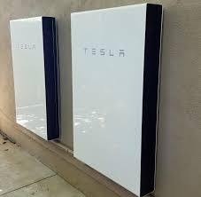
Home Measures
Renewable Energy: Money
  No subsidies for renewable electricity
  Some still for heat (biomass, heat pumps)
  Within a few years, batteries will be cheap enough that they will make solar PV pay for itself in 5-8 years (but not yet, in my experience)

Slide 52
Individuals

Slide 53
Individual Measures
What can we all do?
  Ask your political representatives what the plan is:
    How will we do heat?
    How will we do transport?
    How will we generate all of the electricity and hydrogen renewably? (remember the factor of 25 or 1000!)
  Alter your behaviour:
    Drive less (walk/cycle/bus/train/work from home)
    Fly less
    Turn stuff off!
    Ensure that food waste goes in brown box
    Think about what you buy

Slide 54
Individual Measures
What can we all do?
  Think about what you buy:
    Buy less new stuff (half of UK emissions?)
    Spend more for a more sustainable version
    Buy in-season food
    Reduce consumption of meat and dairy
    Avoid buying palm oil products

Slide 55
Individual Measures
What can we all do?
  Understand the size of the change that is needed:
    The factor of 1,000 in renewable energy in Dorset
    Many aspects of life will need to change
    The UK is going to need spend around £1trillion
    Accept that this is going to impinge on your wealth

Slide 56
Individual Measures
What can some of us do?
  Switch to an electric car:
    Cheaper to tax and fuel
    Much easier to drive
    Currently limited range (90 miles budget models, 300m for £37k) and charge times (20 mins to 8 hrs)
  If you do drive a petrol/diesel car:
    Learn to ecodrive
  Buy locally-sourced container-free food:
    Various local shops
    Balance of this and driving

Slide 57


Questions?
www.lowcarbondorset.org.uk

Slide 58
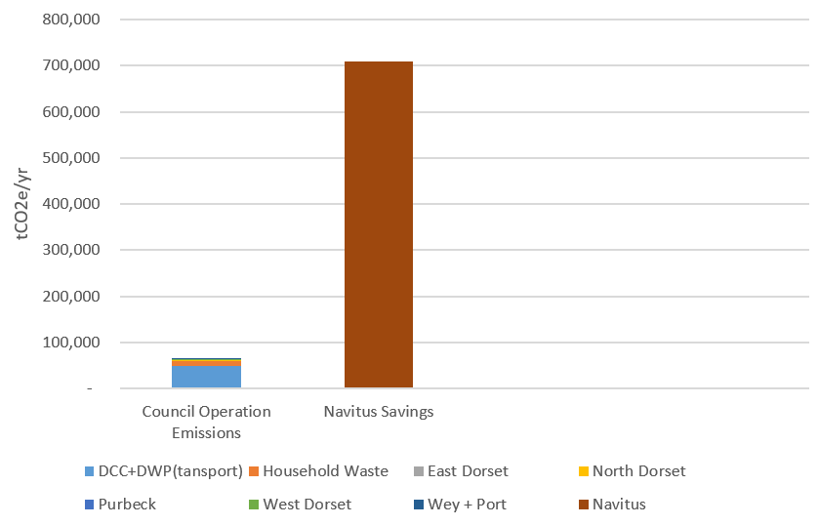
Something?

